Slide 1

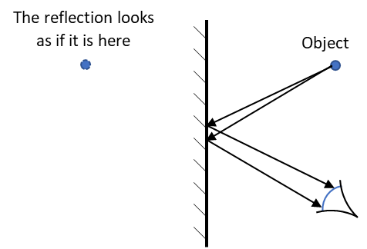
Behind the mirror
In a flat mirror you can see the reflection of an object.
The reflection looks as if it is behind the mirror.

Slide 2
Behind the mirror
Why does the reflection look as if it is behind the mirror?
What is the best reason?
The reflection looks as if it is here
Object
A
The object’s image bounces (reflects) off the mirror
B
The object’s image reflects off the mirror at an equal angle
C
Light appears to come from an object behind the mirror
D
The mirror makes an image of what is in front of it

